Slide 1
SER 334 A Session
SI Session
Thursday, February 1st 2024
7:00 pm - 8:00 pm MST

Slide 2
{
Agenda
Process Tracing
Parallelism
Threading Issues
Dining Philosophers

Slide 3
SI Session Expectations
Thanks for coming to the SER 334 SI session. We have a packed agenda and we are going to try to get through as many of our planned example problems as possible. This session will be recorded and shared with others.
If after this you want to see additional examples, please visit the drop-in tutoring center.
We will post the link in the chat now and at the end of the session.
tutoring.asu.edu
Please keep in mind we are recording this session and it will be made available for you to review 24-48 hours after this session concludes.
Finally, please be respectful to each other during the session.

Slide 4

Interact with us:
Zoom Features
Zoom Chat
Use the chat feature to interact with the presenter and respond to presenter’s questions.
Annotations are encouraged

Slide 5
Module 5 Sample
int main() {
pid_t temp1, temp2, temp3;
temp1 = fork();
if (temp1 < 0) { /* Error occurred */
fprintf(stderr, "Fork Failed");
return 1;
}
else if (temp1 == 0) { /* Process 2 */
temp2 = fork();
if (temp2 < 0) { /* Error occurred */
fprintf(stderr, "Fork Failed");
return 1;
}
else if (temp2 == 0) { /* Process 3 */
temp3 = getpid();
printf("temp2 = %d", temp2); /* A */
printf("temp3 = %d", temp3); /* B */
}
else { /* Process 2 */
temp3 = getpid();
printf("temp2 = %d", temp2); /* C */
printf("temp3 = %d", temp3); /* D */
wait(NULL);
}
}
else { /* Process 1 */
temp2 = getpid();
printf("temp1 = %d", temp1); /* E */
printf("temp2 = %d", temp2); /* F */
wait(NULL);
}
return 0;
}
temp1
SER 334
P1
1502
temp2
Module 5 Sample
4. [Lisonbee] Trace the program below, identify the values of the pids at lines A, B, C, D, E, and F.
(Assume that the actual pid of Process 1 is 1502, Process 2 is 1505, and Process 3 is 1507. Also assume that fork will always succeed.) [4 points]
temp3
temp1
P2
1505
temp2
A
B
C
D
E
F
temp3
temp1
P3
1507
temp2
temp3

Slide 6
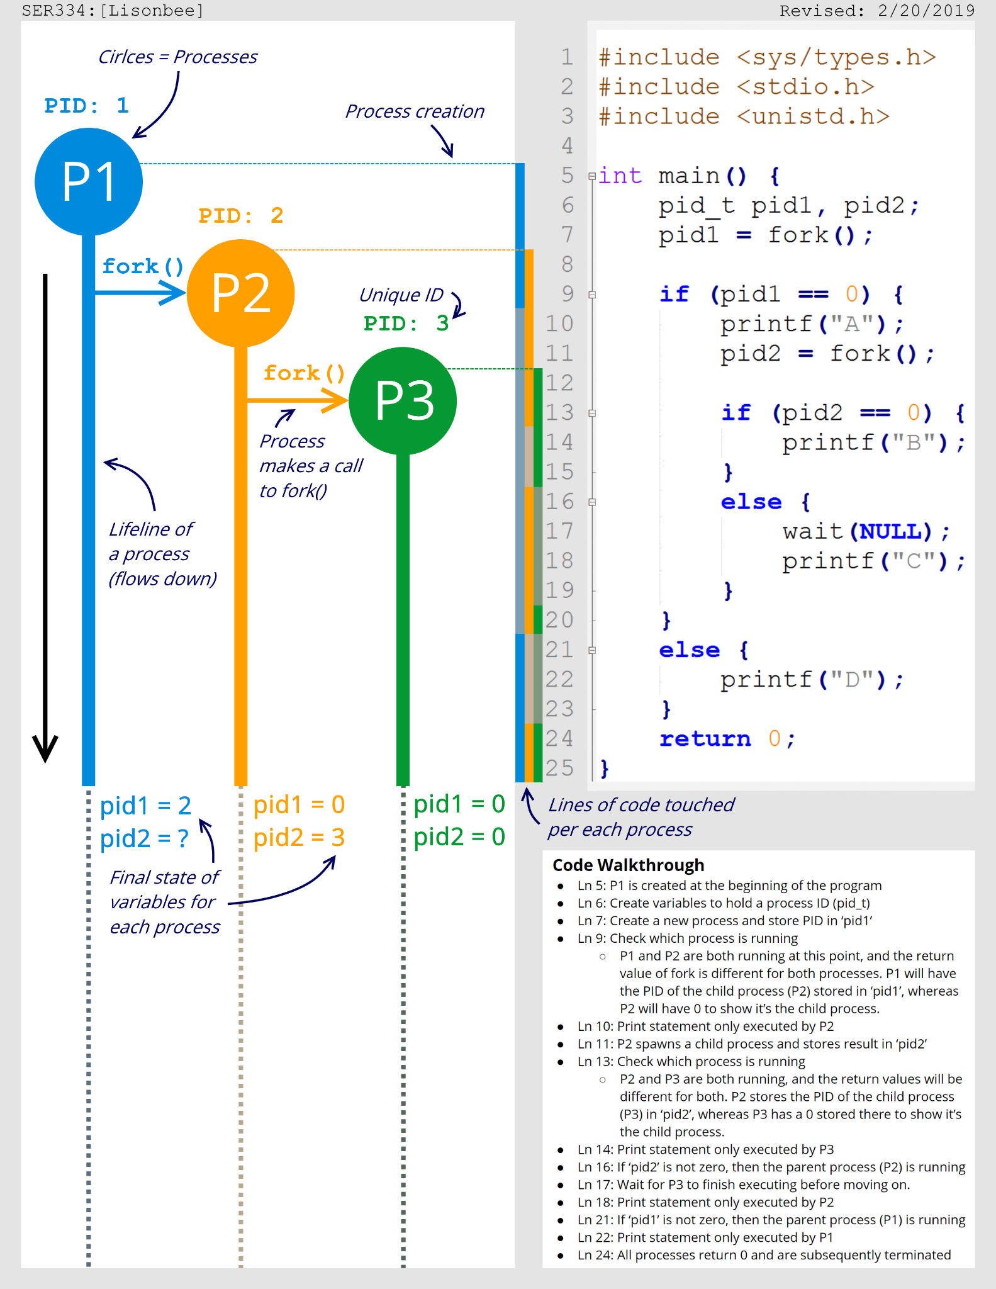
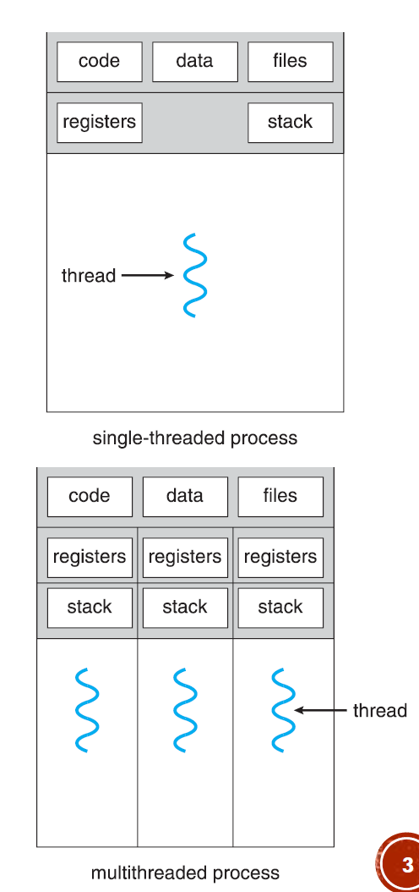
SER 334
Processes & Threads
Process or Thread?

Slide 7

SER 334
Depicting Threads
You get a stack!
You get a stack!
pthread_create

Slide 8
SER 334
Depicting Threads
How do we depict this?

Slide 9
SER 334
Depicting Threads
What does that imply?
Threads do not get individual copies of code or data
Notes:
Shared memory!
Need to use concurrency structures to protect the critical secion

Slide 10
Module 6 Sample
4. [Silberschatz 4.15 edited] Consider the following code fragment and answer the following questions:
(a) Using “lifeline notation”, draw the creation of processes and threads during execution.
(b) How many unique processes are created? (Do not include the initial process.)
(c) How many unique threads are created? (Hint: processes don't count!)
SER 334
Module 6 Samples
pid_t pid;
temp = fork();
if (temp == 0) {
fork();
}
thread_create(...);

Slide 11
Foreshadowing for CPU scheduling!
SER 334
What’s the difference??
Multi-Threading
Parallelism
Concurrency
vs.
Simultaneous Execution
Near-Time Execution
Run at the same time
Exist at the same time
Notes:
Parallelism - both actually running @ same time
Concurrency - both exist, not both executing @ same time - think scheduler!

Slide 12
SER 334
Parallelism Types
Data Parallelism
Task Parallelism
vs.
Same Task
Different Data
Same Data
Different Task

Slide 13
SER 334
Parallelism Types
Data Parallelism
Task Parallelism
vs.
Many data sets
Same Task
Different Data
Same Data
Different Task
One data set

Slide 14
SER 334
Threading Issues
Test and Debugging
Data Splitting
Identifying Tasks
Data Dependency
Balance
Identifying independent functionality
Ensuring comparable amounts of work
Partitioning and minimizing memory use
Some tasks must be performed sequentially
Multiple “executors” for each line makes it harder to identify the culprit

Slide 15
SER 334
Threading Issues
E
Identifying independent functionality
Ensuring comparable amounts of work
Partitioning and minimizing memory use
Some tasks must be performed sequentially
Multiple “executors” for each line makes it harder to identify the culprit
Test and Debugging
Data Splitting
Identifying Tasks
Data Dependency
Balance
C
A
D
B

Slide 16
Module 5 Sample
SER 334
Enter topic here
6. [Lisonbee] Consider a system where two processes (a producer and a consumer) use a message-passing system to communicate, and each process does work at different rates. The producer can produce (perform work) at any rate, but the consumer has to wait for the producer to complete its task before moving on. Based on this system's needs, explain whether a synchronous or asynchronous communication system would be a better choice and why. [2 points]
Synchronous
Asynchronous

Slide 17
Module 6 Sample
int fib(int n) {
if (n == 0)
return 0;
else if (n == 1)
return 1;
return fib(n-1) + fib(n-2);
}
void* runner(void* param) {
int n = (int)param;
printf("Fib @ %d is %d\n", n, fib(n));
pthread_exit(0);
}
void threadded_fib(int* arr, int size) {
pthread_t threads[size];
for (int i = 0; i < size; i++) {
pthread_create(&threads[i], NULL, runner, (void*)arr[i]);
}
for (int i = 0; i < size; i++) {
pthread_join(threads[i], NULL);
}
}
int main() {
int nums[] = {1, 6, 15, 2, 89};
int size = 5;
threadded_fib(nums, size);
return 0;
}
SER 334
Module 6 Sample
3. [Lisonbee] Consider the following program and answer the question:
Of the five issues in multi-core programming, which is the most problematic for this problem?

Slide 18
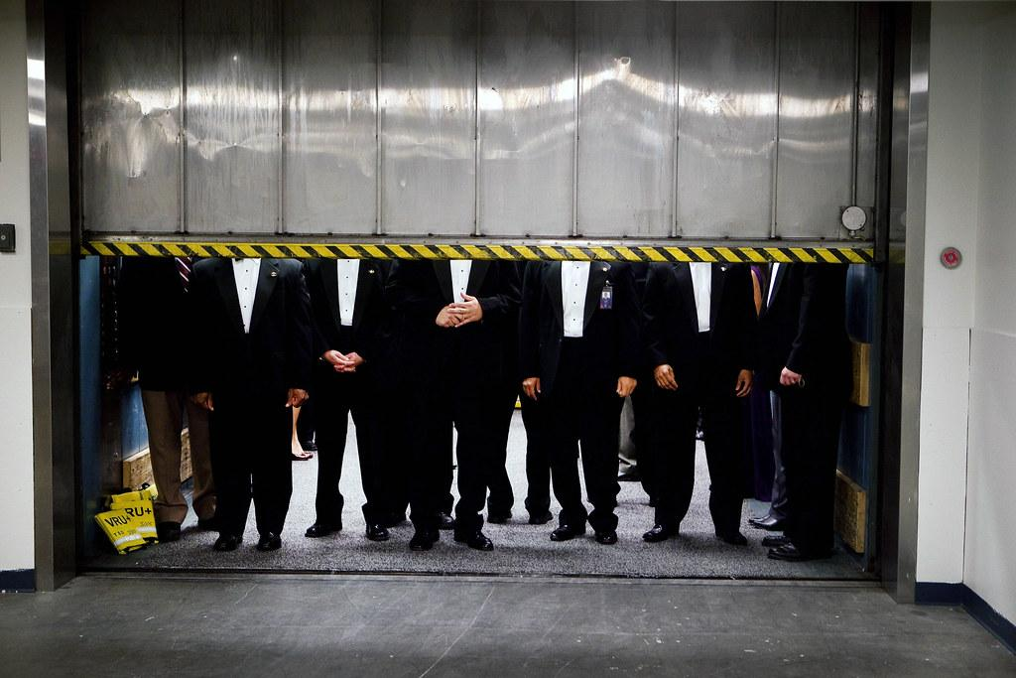
SER 334
Stepping on each other’s toes
Critical Section
What is the Critical Section?
Area of code where thread execution can impact other threads
Notes:
Threads step on each other

Slide 19
SER 334
Critical Section
The solution needs to ensure…
Race Condition
Mutual Exclusion
Progress
Bounded Waiting Time
Deadlock
Starvation

Slide 20
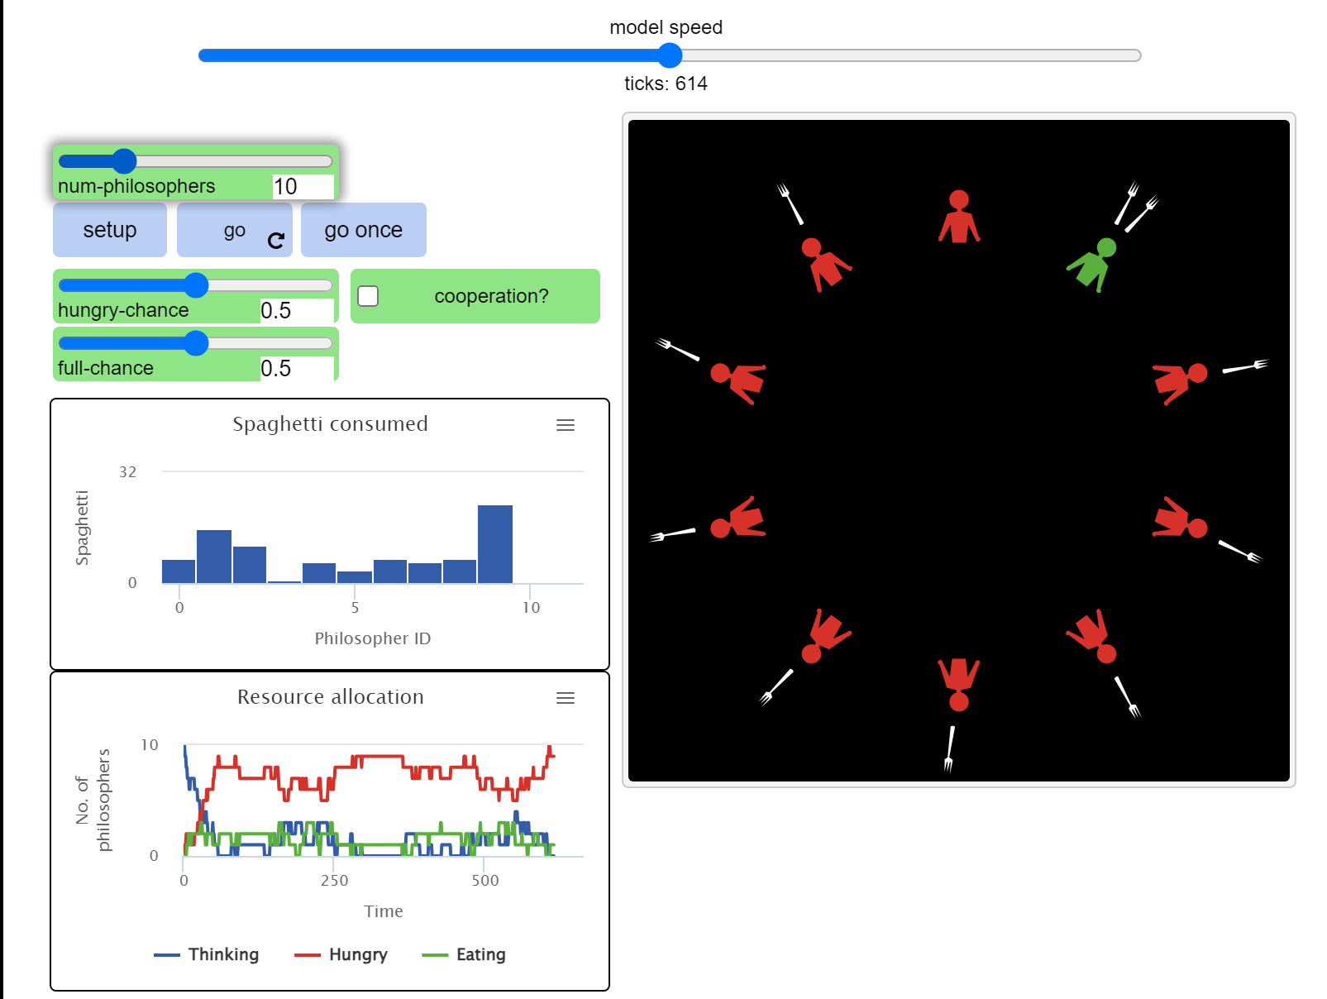
SER 334
Dining Philosophers
Critical Section
Race Condition
Deadlock
Starvation
Notes:
Threads step on each other

Slide 21
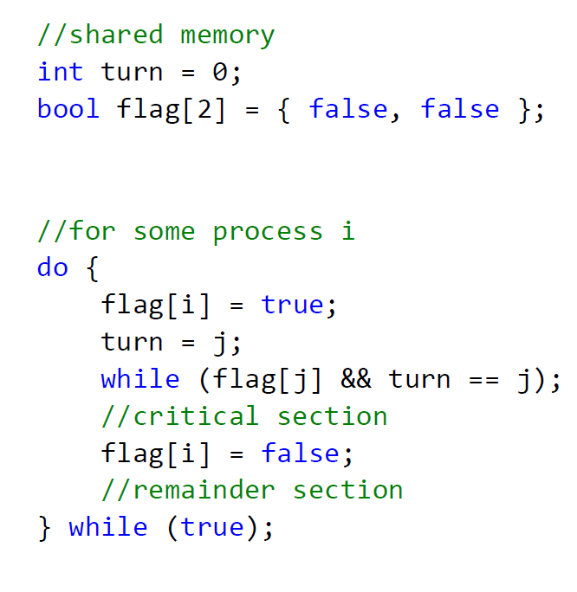
SER 334
Peterson’s Solution
I want to go

Slide 22
SER 334
Peterson’s Solution
I want to go
But you can go first…

Slide 23
SER 334
Peterson’s Solution
I want to go
But you can go first…
Wait for my turn

Slide 24
SER 334
Peterson’s Solution
I want to go
But you can go first…
Wait for my turn
Dangerous Stuff

Slide 25
SER 334
Peterson’s Solution
I want to go
But you can go first…
Wait for my turn
Dangerous Stuff
I’m done

Slide 26
SER 334
Scratch Space

Slide 27
Upcoming Events
SI Sessions:
Sunday, February 4th at 7:00 pm MST
Monday, February 5th at 7:00 pm MST
Sunday, February 11th at 7:00 pm MST Cancelled - Good luck on Exam 2!
Review Sessions:
Exam 2 Review: Thursday, February 8th 7:00 pm - 9:00 pm MST
Exam 3 Review: TBD

Slide 28

Questions?
Survey:
http://bit.ly/ASN2324

Slide 29


More Questions?
Check out our other resources!
tutoring.asu.edu
1-
2-
Click on ‘Go to Zoom’ to log onto our Online Tutoring Center.
Click on ‘View the tutoring schedule’ to see when tutors are available for specific courses.

Slide 30
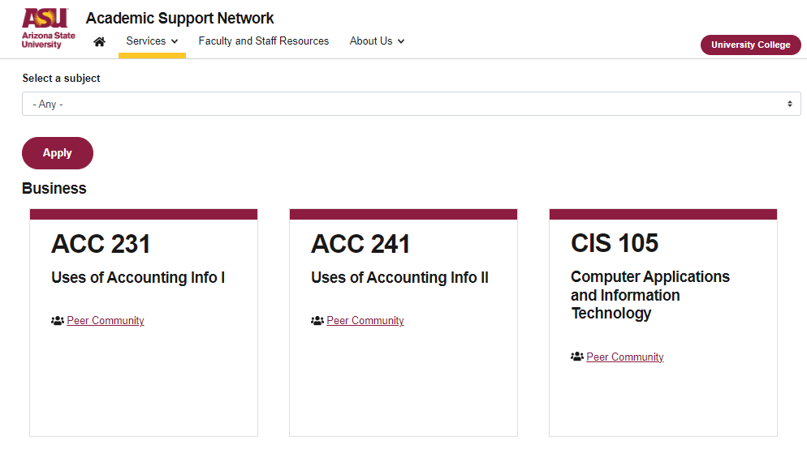

More Questions?
Check out our other resources!
tutoring.asu.edu/online-study-hub
Don’t forget to check out the Online Study Hub for additional resources!

Slide 31
Additional Resources
Course Repo
Course Discord
BMP File Format (Wiki)
Linux Kernel API
Bootlin - Linux Cross Referencer
Dining Philosophers Interactive

